Slide 1
Classroom Rocket Scientist
Chris North, Sarah Eve Roberts, Stuart Lowe

Slide 2
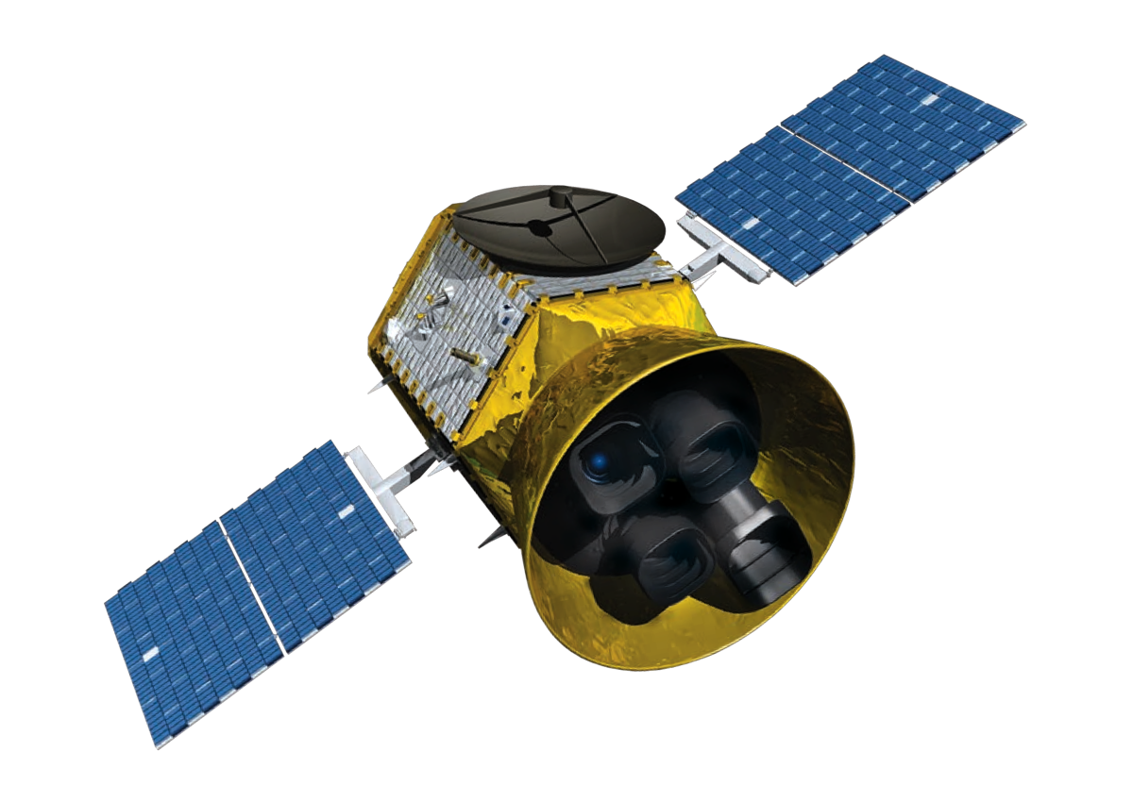
What is a Satellite?
A satellite is anything that orbits around something else.
An active, artificial satellite has a specialised wireless receiver and transmitter and is launched by a rocket into orbit.

Slide 3
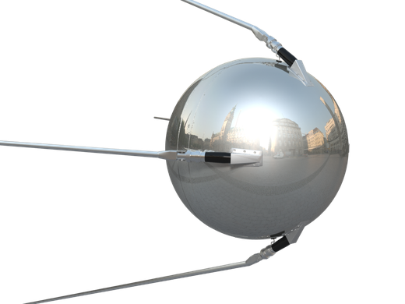
History of Satellites
The first satellite was Sputnik 1, launched into space in 1957 by the Soviet Union.
The satellite provided information about the highest layers of our atmosphere.

Slide 4
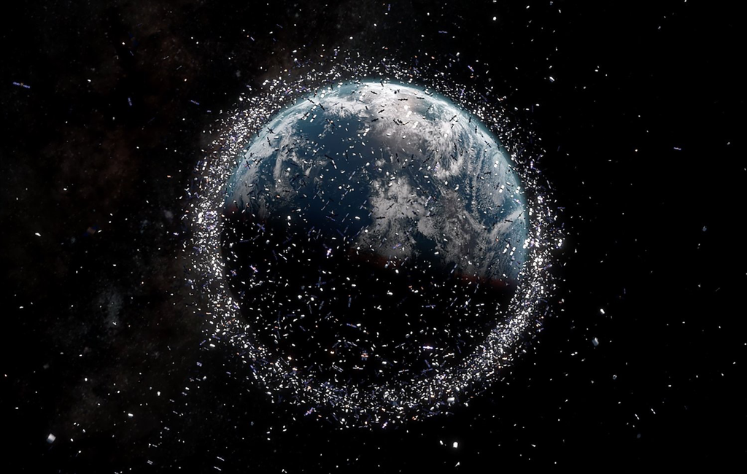
Types of Satellite
Today there are thousands of satellites orbiting our planet

Slide 5
Types of Satellite
Satellites come in all shapes and sizes and play a variety of roles.
Earth
Observation
Communications
Navigation
Communications satellites allow us to watch TV, make long distance phone calls, listen to the radio and browse the Internet.
Earth observation helps us map, monitor and protect the environment, manage resources, respond to global disasters and enable sustainable development.
Navigation satellites can determine a location anywhere on the Earth’s surface to within a metres or better, whatever the weather .

Slide 6
Types of Satellite
Satellites come in all shapes and sizes and play a variety of roles.
Telephone
Internet
Communications
Communications satellites allow us to watch TV, make long distance phone calls, listen to the radio and browse the Internet.
Radio broadcast
Television
Military

Slide 7
Types of Satellite
Satellites come in all shapes and sizes and play a variety of roles.
Weather
Earth
Observation
Search & Rescue
Earth observation helps us map, monitor and protect the environment, manage resources, respond to global disasters and enable sustainable development.
Vegetation mapping
Climate monitoring
Agriculture

Slide 8
Types of Satellite
Satellites come in all shapes and sizes and play a variety of roles.
Personal use
Travel by air
Navigation
Navigation satellites can determine a location anywhere on the Earth’s surface to within a metres or better, whatever the weather .
Travel by road
Travel by water
Military

Slide 9
How Satellites Work
A satellite consists of following major components:
Structure: The body of the satellite.
Instrumentation: The onboard instruments that steer the satellite, collect data, and more.
Power source: To provide electricity to the satellite. Solar panels and batteries are two options.
Communication device: A way to communicate with ground control and send data back to Earth.
Propulsion system: The engine that keeps the satellite in orbit.

Slide 10
How Satellites Work
A satellite consists of following major components:
Instrumentation
Structure
Power source
Propulsion system
(not visible)
Communication device

Slide 11
How Satellites Work
(Basics)
2. Satellite receives and amplifies the signal, changing the frequency
1. Ground control transmits
radio signal to satellite
3. Satellite transmits
signal back to Earth
4. Signal from satellite is received on Earth

Slide 12
Instrumentation
All satellites need scientific instruments to carry out their purpose.
Here is are some examples of instruments:
Atomic Clock: A very accurate clock, required by navigation satellites to measure the time very precisely.
Optical Camera: Provides images of the ground or clouds, for mapping or for monitoring natural disasters, e.g.
Infrared Camera: Provides images of the clouds and weather systems in the Earth's atmosphere, for weather forecasting e.g.
Internet Encoder: Used to broadcast the internet to people around the world.
Radio Dish: Used for controlling the satellite and transmitting data to the ground

Slide 13
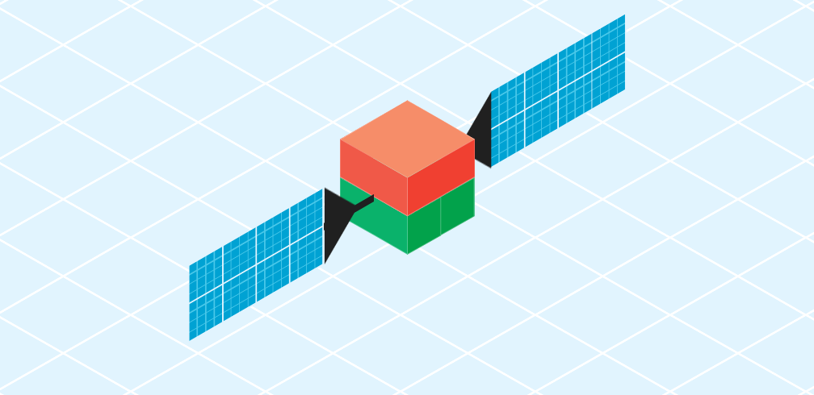
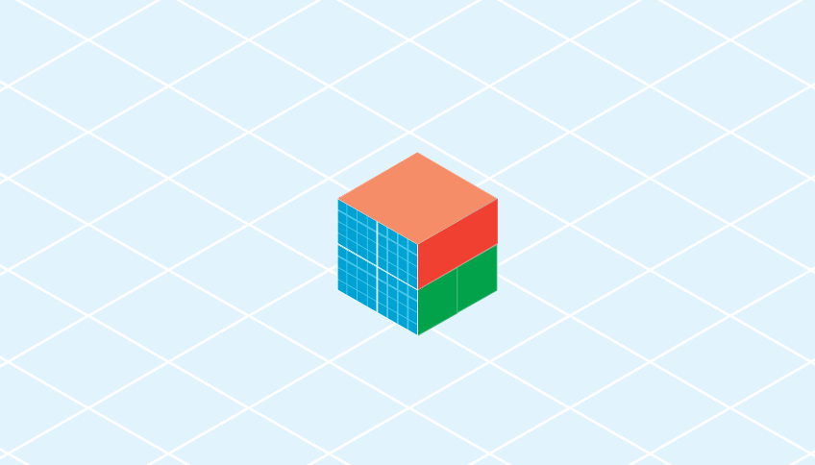
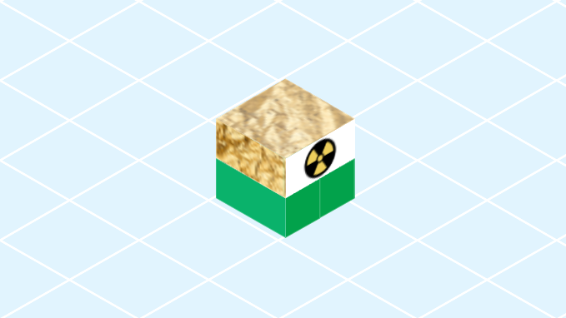
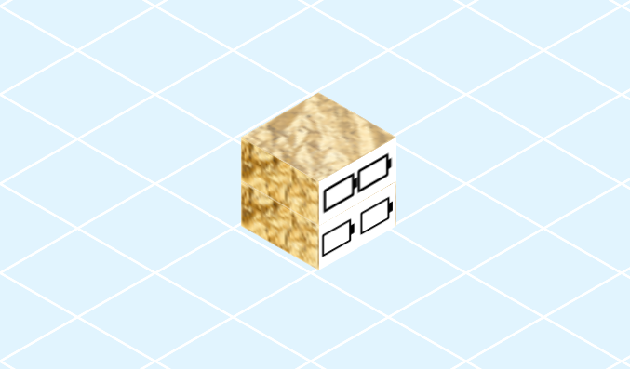
Power Sources
All satellites require electricity to run. The more instruments onboard, the more power a satellite will require. Here are some possible power sources:
Deployed solar panels:
Extend from edge of satellite, collecting sunlight to provide power.
Mounted solar panels:
Cover the surface of satellite, collecting sunlight to provide power.
RTG:Uses nuclear technology to provide power. Due to safety concerns, it can't be used in low-Earth orbit.
Batteries: Stores power from solar panels to allow operation when not in sunlight.

Slide 14
Satellite Orbits
Satellites orbit Earth at different heights, speeds, and paths.
Highly-elliptical orbit
Low-earth orbit
Medium-earth orbit
Geostationary Orbit
Altitude: 400km
Altitude: 20,000km
Altitude: 37,786km
Altitude: 2,000km
Period: 90 mins
Period: 24 hours
Period: 12 hours
Period: 2 hours
- See the surface of the Earth in high detail
- Pass over a different part of the Earth in each orbit.
- Cheaper than other orbits and they can be reached for repairs.
- Stay above the same location on Earth near the equator and complete a full orbit in 24 hours.
- Much higher above the Earth's surface than other orbits, so can see the entire hemisphere in less detail.
- Higher above the Earth than low-Earth orbits, but lower than geostationary orbits.
- Cover a different part of Earth in each orbit.
- See a larger area in less detail than low-Earth orbits.
Elliptical orbit that is closer to the Earth at one point in their orbit than anothe
Useful for covering areas including polar regions.
- More than one satellite can be used for continuous coverage of an area.
Notes:
Satellites in low-Earth orbit pass over a different part of the Earth in each orbit. It is cheaper to send satellites to Low-Earth orbit than other orbits and satellites here can be reached for repairs. Low-Earth orbit satellites can look at small areas in high detail for short periods of time.
Altitude: 400km
Period: 90 mins
- most in

Slide 15
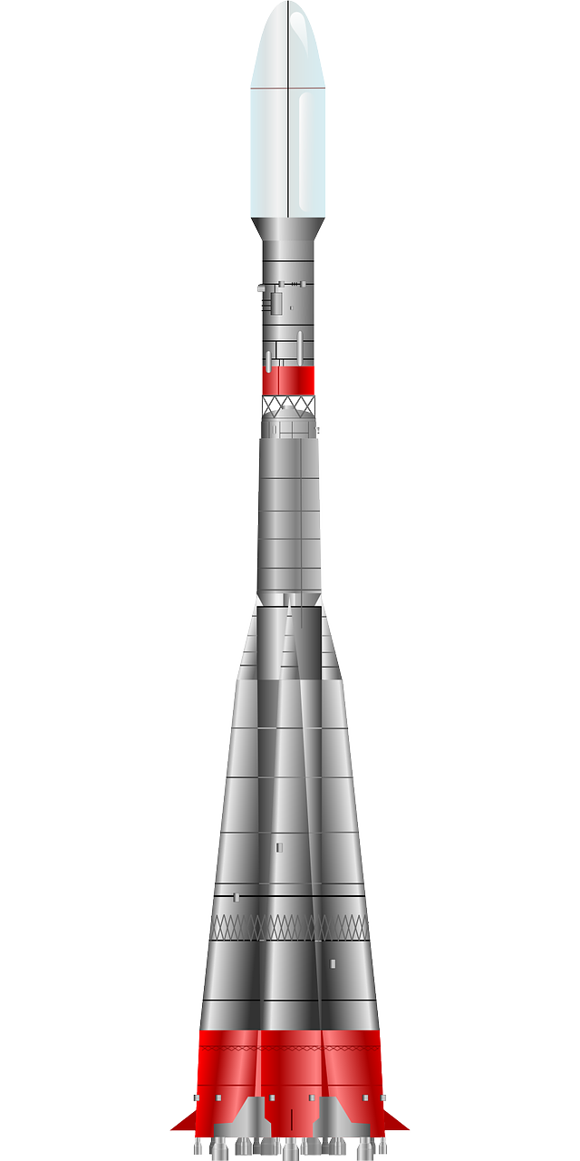
Launching a Satellite
Launching satellites is a very complex business which involves years of hard work and a lot of money. A few things that must be taken into account are:
1. The rocket must be large enough to carry the satellite (also called the “payload”)
Thrust
2. Two main forces act on a rocket: Thrust upwards and Weight downwards
Weight
3. The heavier a satellite the more thrust is needed to launch it into orbit.

Slide 16
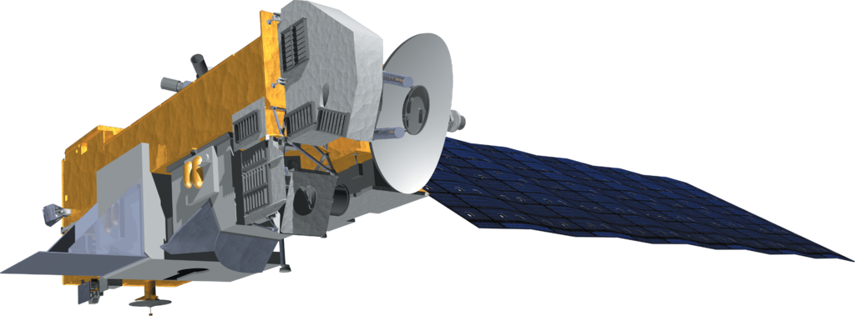
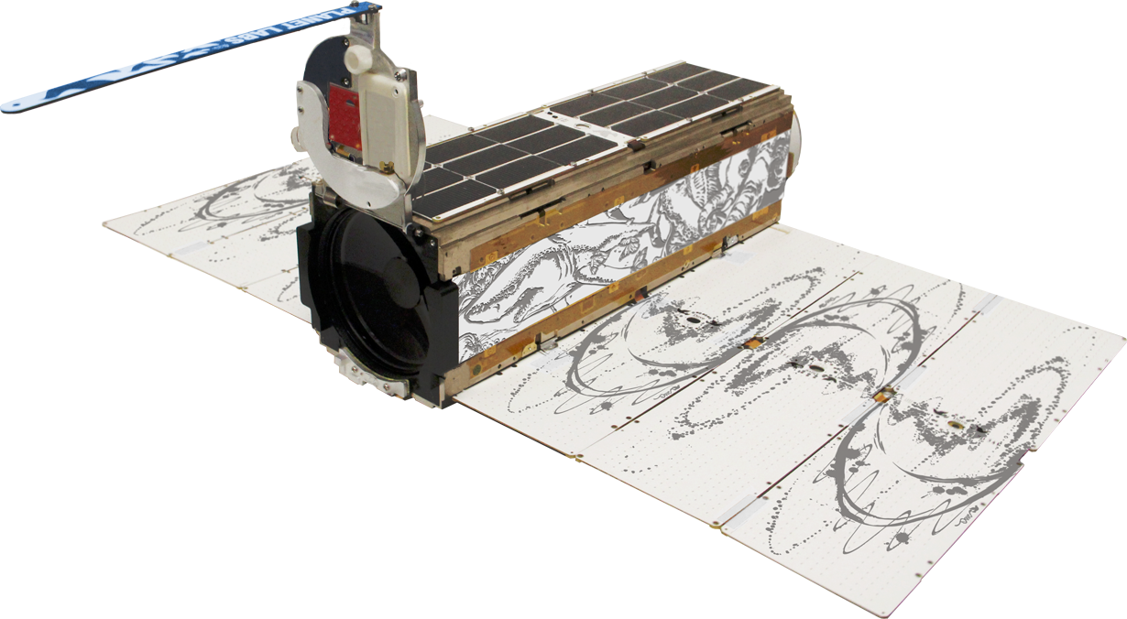
Satellite Examples (EARTH OBSERVATION)
ENVISAT
Atmosphere and ocean monitoring
DIMENSIONS: 2.5 × 2.5 × 10 M (LARGE)
MASS: 8,211 KG
ORBIT: LOW-EARTH ORBIT
INSTRUMENTS: 9
DISASTER MONITORING CUBE SAT
DIMENSIONS: 10 x 10 x 34 cm (mini)
MASS: 5 KG
ORBIT: LOW-EARTH ORBIT
INSTRUMENTS: 4
PLANETLABS

Slide 17
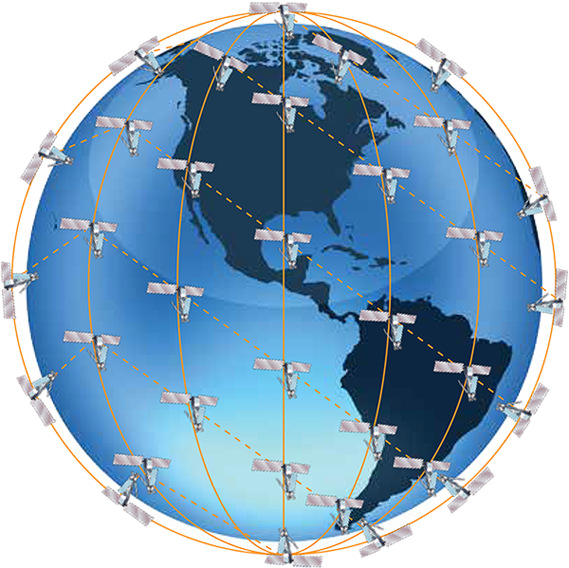
Satellite Examples (NAVIGATION)
GaliLeo satellite
CONSTELLATION
NAVIGATION SATELLITES
# SATELLITES: 34
DIMENSIONS: ~2.5 x 14.5 x 1.5 M
MASS: ~7OO KG
ORBIT: MEDIUM-EARTH ORBIT
INSTRUMENTS: 11

Slide 18
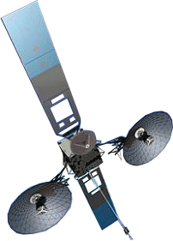
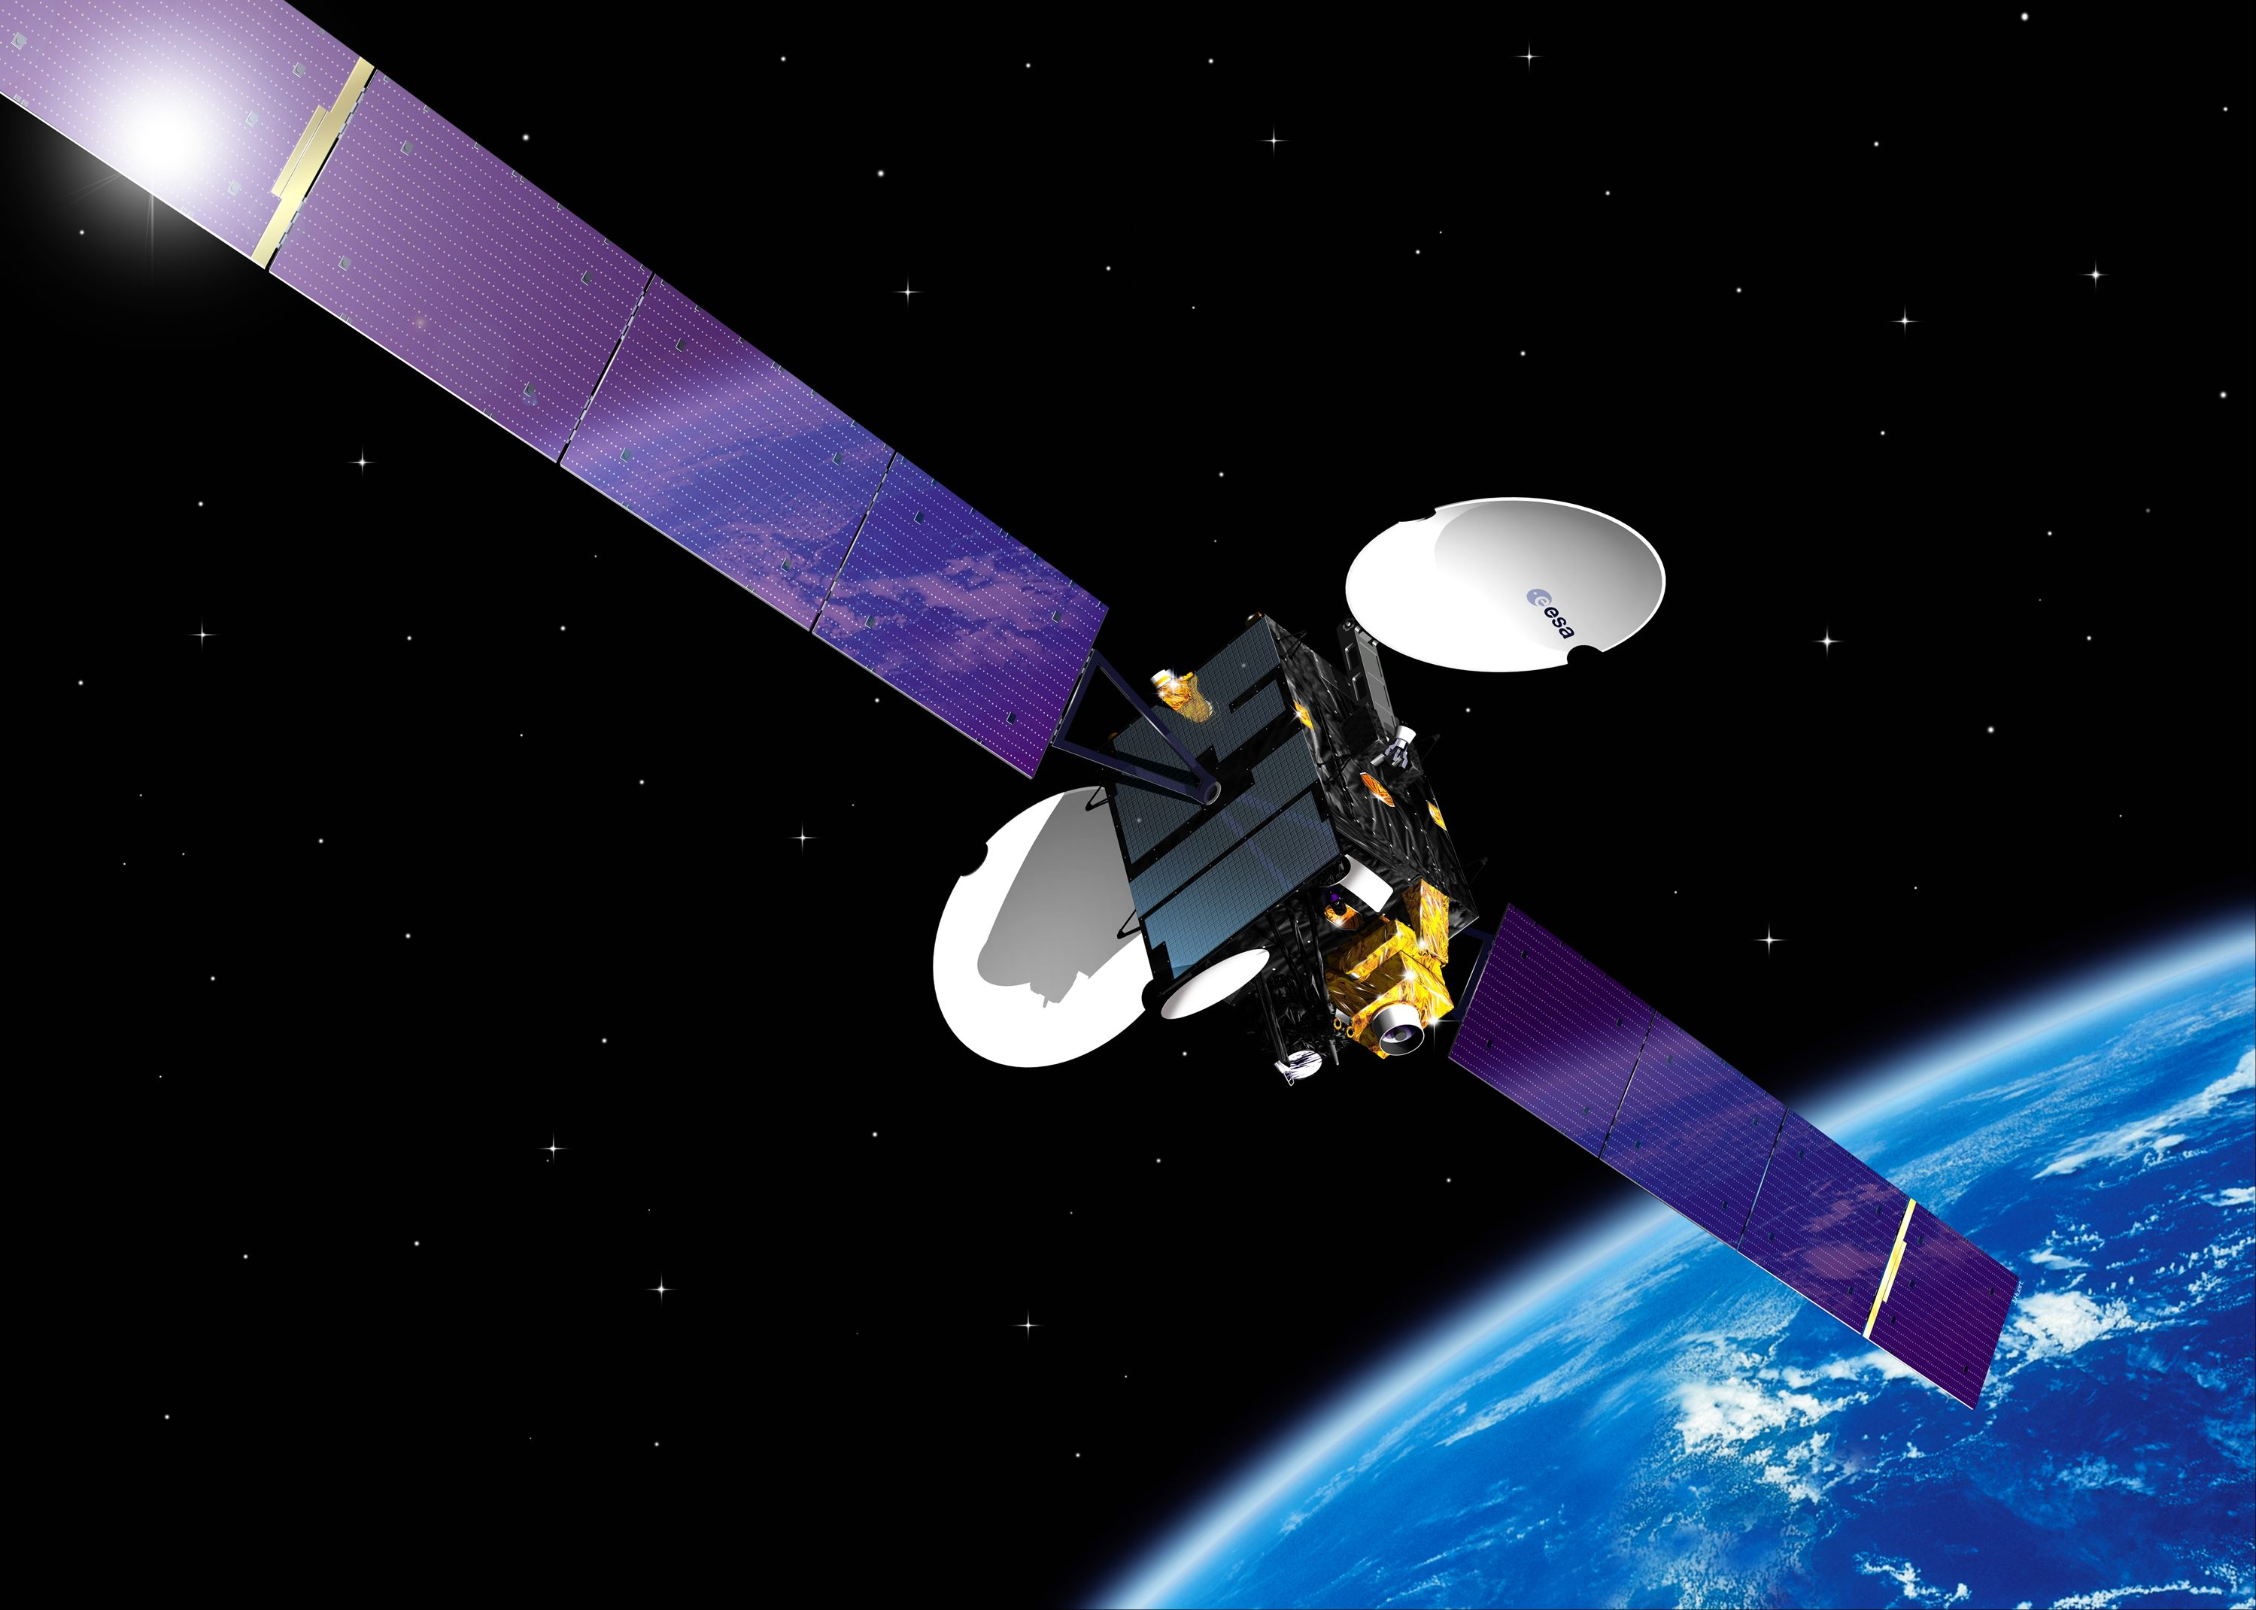
Satellite Examples (COMMUNICATION)
Tracking and data relay
DIMENSIONS: 21 × 13 M (LARGE)
MASS: 3,700 KG
ORBIT: GEOSTATIONARY EARTH ORBIT
INSTRUMENTS: 7
TDRS-M
TDRS-M
ARTEMIS
TELECOMMUNICATIONS
DIMENSIONS: 4.8 × 25 × 8 M (LARGE)
MASS: 3,100KG
ORBIT: GEOSTATIONARY EARTH ORBIT
INSTRUMENTS: 7

